Slide 1
Story Sharing Website
Noyan
Gordon
Soham

Slide 2
Idea
Create a story sharing website for new or aspiring writers
People can write about what they want e.g. stories, auto-biographies etc.
Easily accessible and not too complex
Writers can make money through writing
Copying and pasting disabled
Writers cannot get reputation points without publishing stories

Slide 3
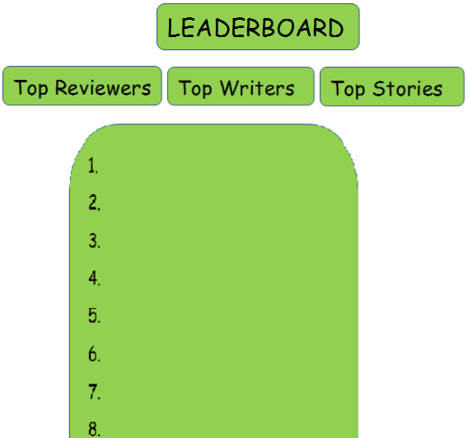
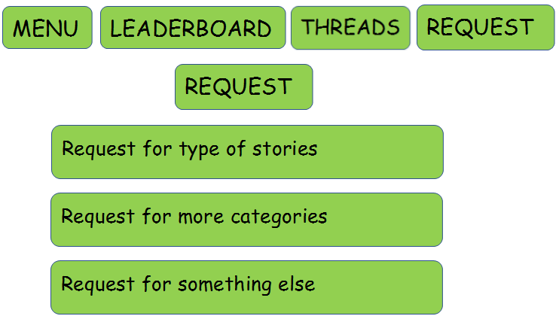
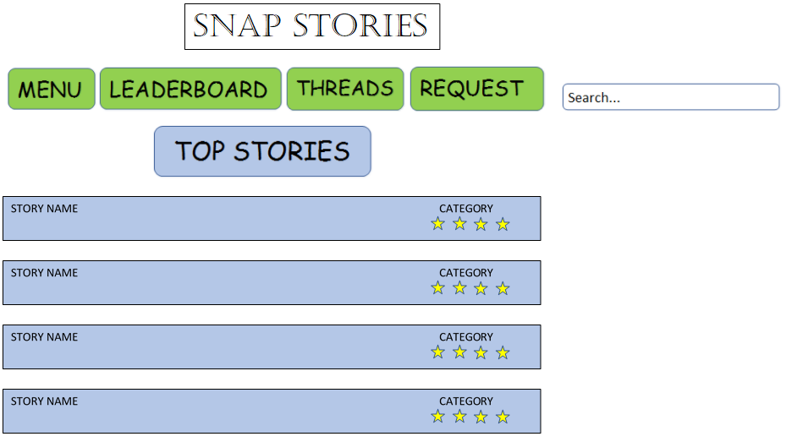
Unique Selling Point
Target audience is everyone who enjoys reading and writing
It is very simple to use
Gap in market
More accessible to amateur writers, includes a complete WYSIWYG editor so no need to learn any kind of mark up
Writers can kick-start careers without resources needed for publishing
Basic Design:

Slide 4
Finance Plan
Readers can read the first 2 pages before payment is necessary, to capture their interest
Writers get 5 free stories on sign-up a we get 30% of the revenue from free stories. Writers get 1 free chapter every week to keep them coming back.
When writer starts paying for stories, we take 15% of revenue
Writer sets price of story, but we have algorithm running showing optimal price based on story length and user reputation points
Writers can subscribe which will give discounted price per story upload
Readers can sponsor writers
Ad revenue
Ad free experience (Only £1.99 per month)

